Slide 1


Creating VALUE:
Strategies for High-Earning, Happy Engineering Teams
Denis Čahuk
Engineering Leadership Coach

Slide 2
Who am I?
Engineering Leadership Coach
➡ Empowering engineering leaders to master PRODUCTIVE leadership

Slide 3
Most Engineers have never had the opportunity to work in a high performing team

Slide 4
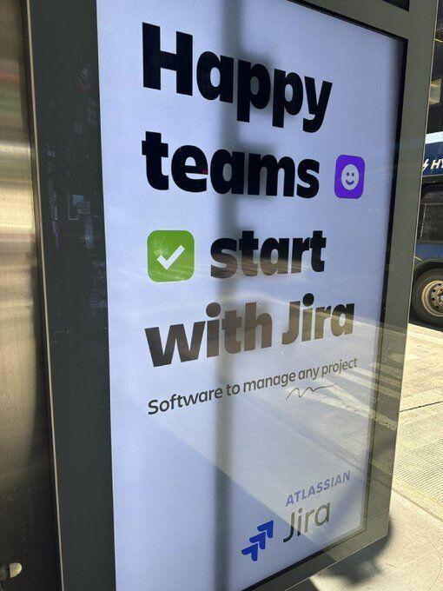
🤮

Slide 5
What you’ll take from this
How to build software products with Accurate Planning
How to Nurture Performance in Engineering Teams
Combine Performance + Accuracy into a High-Ticket Offer

Slide 6
A client with a risky project serviced by a burnt out team will confuse the lack of impact in their strategy with the perceived incompetence of the team, thus demanding a lower price.

Slide 7
Athletes achieve high performance by finding the optimal growth progression while preventing ALL INJURY

Slide 8
Worst Offender
Hourly Billing
+
SCRUM(fall)

Slide 9
HIGH TICKET OFFER = HOURLY RATE x HOURS
???
???
Happy clients?

Slide 10
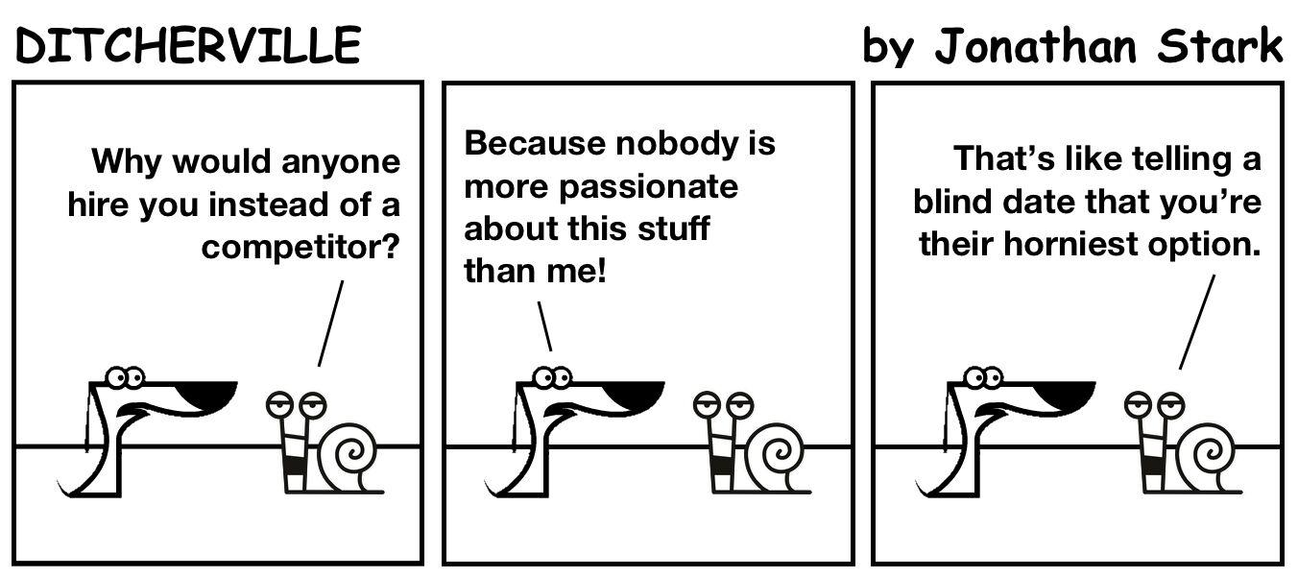

Slide 11
Passion is an Output,
NOT an Input
—Simon Sinek, probably

Slide 12
Strategy Tip #1: Improve Planning Accuracy with reliable and consistent behavior

Slide 13
If you want to be ON TIME
You must be on time EVERY DAY

Slide 14
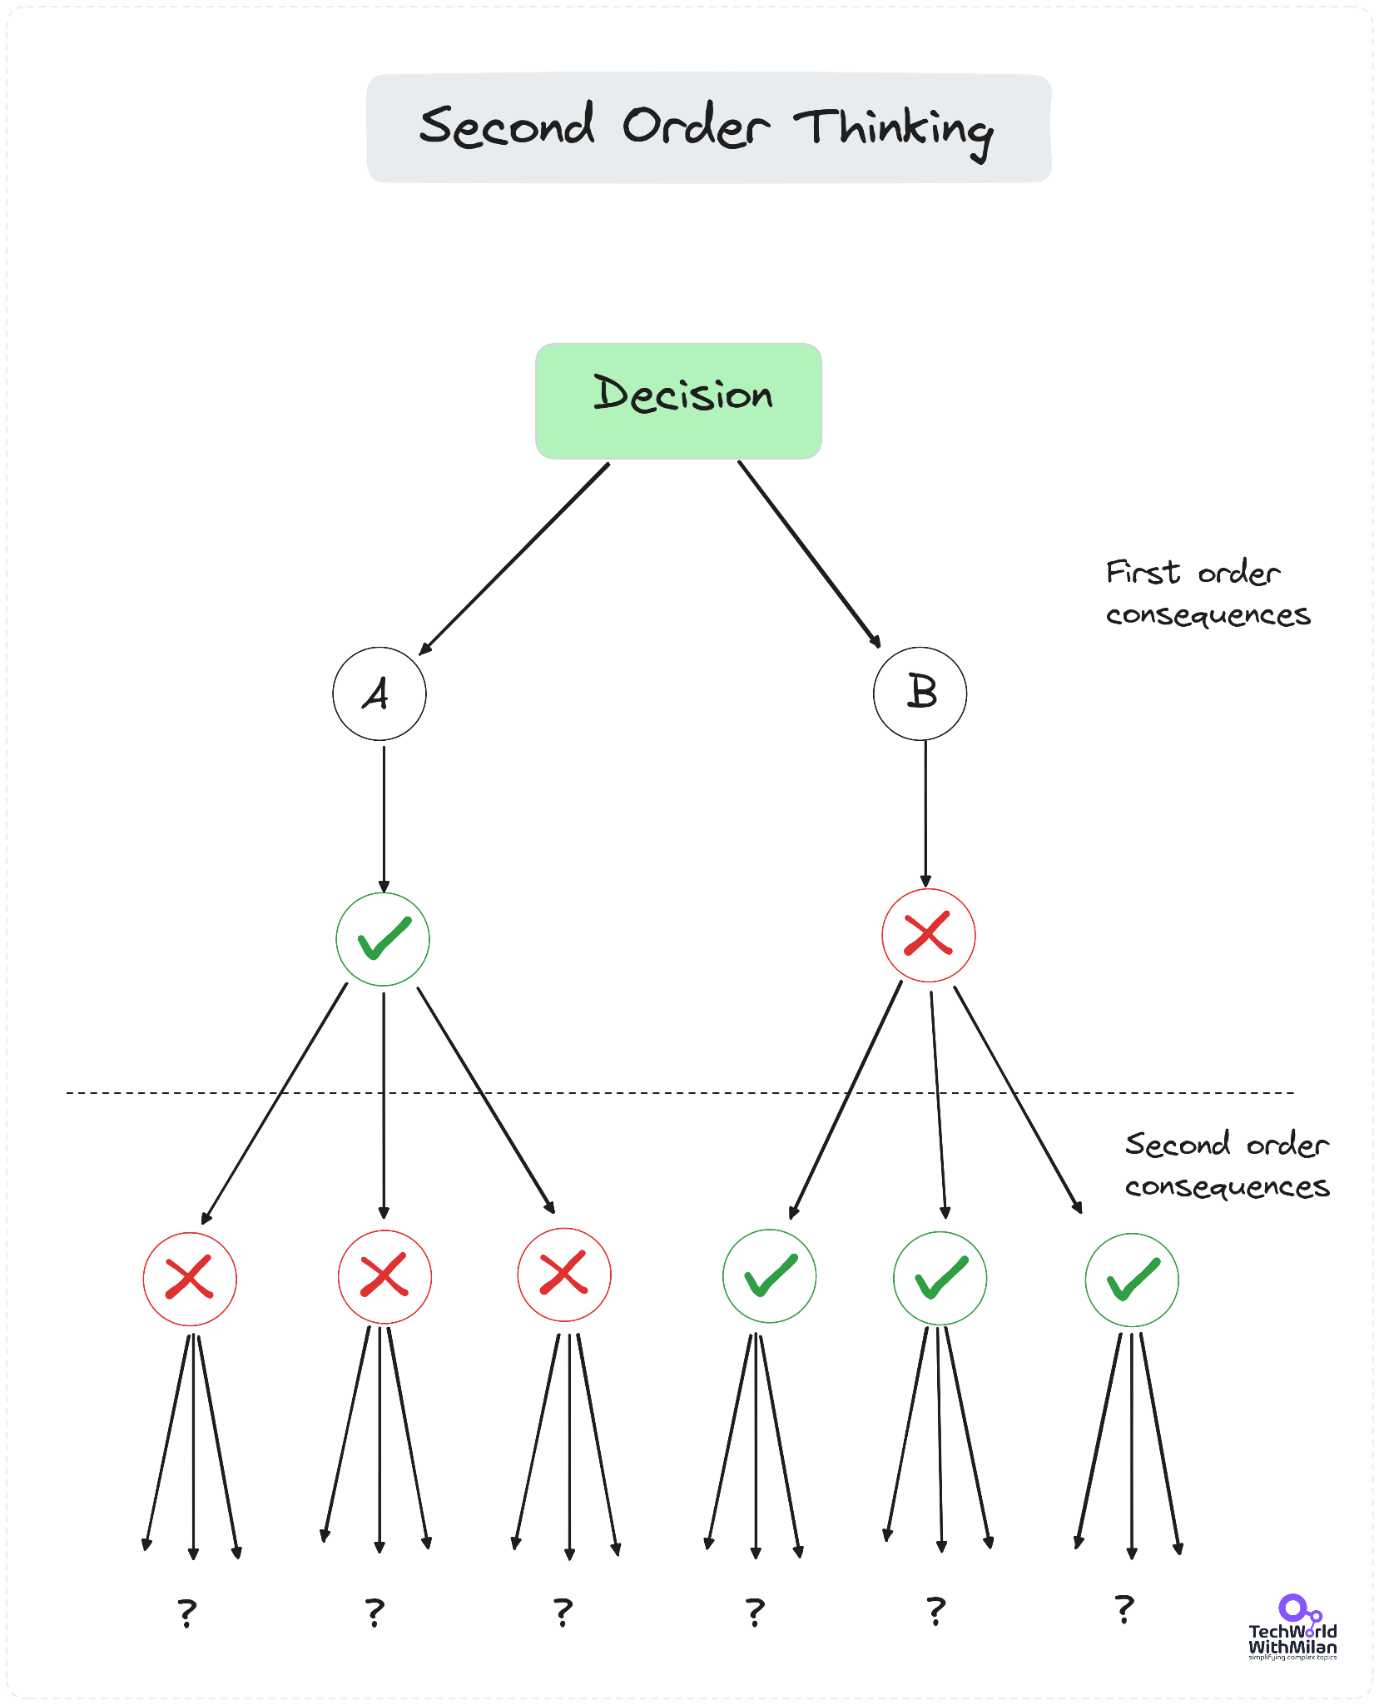

Slide 15
No HEROICS!

Slide 16
“The difference between experts and beginners is that experts find more ways to reward themselves while they work.
Experts are not more disciplined, they just found more ways to win.”
—Alex Hormozi

Slide 17
How do you find your optimal PRODUCTIVITY?

Slide 18
Paying Clients Judge Engineering primarily by their ability to deliver on their expectations and the quality of their communication when they don’t

Slide 19
Planning Accuracy
Set a time limit (e.g. 1 week)
Make a list. Finishing everything on the list is 10/10.
Do exactly what you said you would (and little else)
STOP the list when discovering 10/10 would be counterproductive
STOP if the list changes before you got past 5/10
REDUCE the time limit for subsequent rounds for scores <8
INCREASE time limit when you reach 10/10 twice in a day
Let everyone know you are course correcting

Slide 20
“We learn who we are in practice, not in theory.”
—Herminia Ibarra

Slide 21
Strategy Tip #2: Incentivise engagement
and minimise burnout

Slide 22
Train your team to process and prevent burnout

Slide 23
“Prior studies have examined burnout and engagement, however few studies have investigated their consequences. [...] The researchers here sought to fill that gap: they wanted to understand whether there’s a relationship between three factors—leadership support, organizational culture, and opportunities to learn—and burnout, engagement, or developers’ intention to stay. “
—Abi Noda, Predicting developer attrition;
Predicting Attrition among Software Professionals: Antecedents and Consequences of Burnout and Engagement

Slide 24
Study Findings
Leadership Support helps reduce BURNOUT, but does not affect ENGAGEMENT much
Culture influences ENGAGEMENT the most, has impact on (lessening) BURNOUT
Opportunities to learn heavily improve ENGAGEMENT

Slide 25
Optimise for Performance at the LEVEL which consistently avoids Burnout
TL;DR: High standard, but NO HEROICS

Slide 26
Strategy Tip #3: Your high-ticket offer manages the most risk for the client

Slide 27
Money is an Exchange of Trust

Slide 28
Profit Margins go to the Party that manages the MOST RISK

Slide 29
Value is not just CREATED
It is VALIDATED

Slide 30
Most VALUE to the Client?
A
Delivered
Software
B
Higher
Conversion
Rates
C
Guaranteed
Maintenance

Slide 31
Most RISK to the Client?
A
Uncertain
Delivery Date
B
Uncertain
Cost
C
Uncertain
Impact

Slide 32
Best DEAL?
A
Uncertain increase to CONVERSIONS
Variable Cost
Variable Scope
B
Multiple Attempts
At Validating CONVERSION Impact
Fixed Cost
Variable Scope
C
Commitment to plan/contract
Variable Cost
Fixed Scope

Slide 33
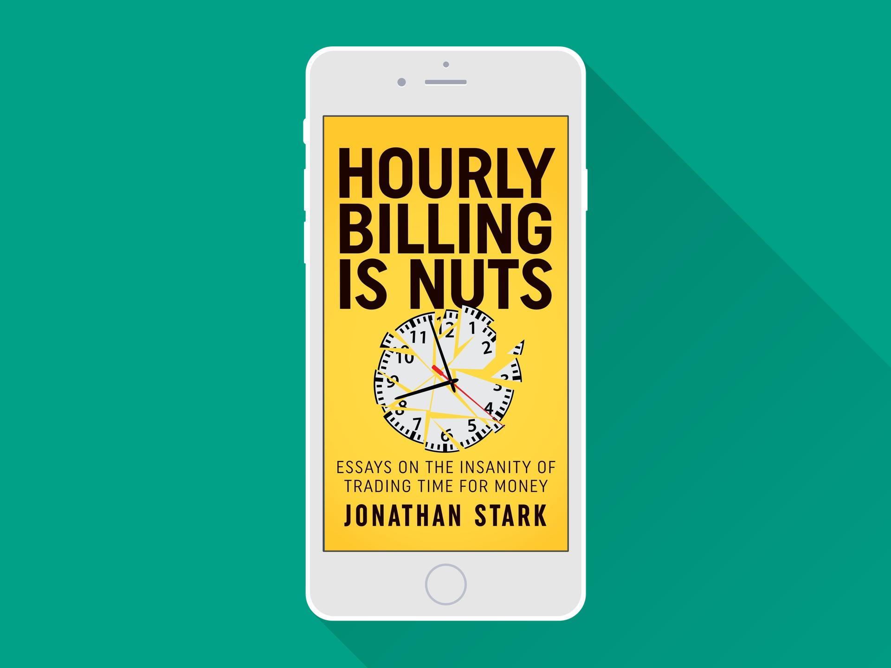
More about Billing…

Slide 34
What does pricing have to do with iterative development and burnout?

Slide 35
High Ticket Offer = Consistent, Engaged Performance to Handle Risk + Burnout Prevention

Slide 36
Some people love change.
Others don’t.

Slide 37
It only takes one
person to ignite change.

Slide 38
YOU

Slide 39
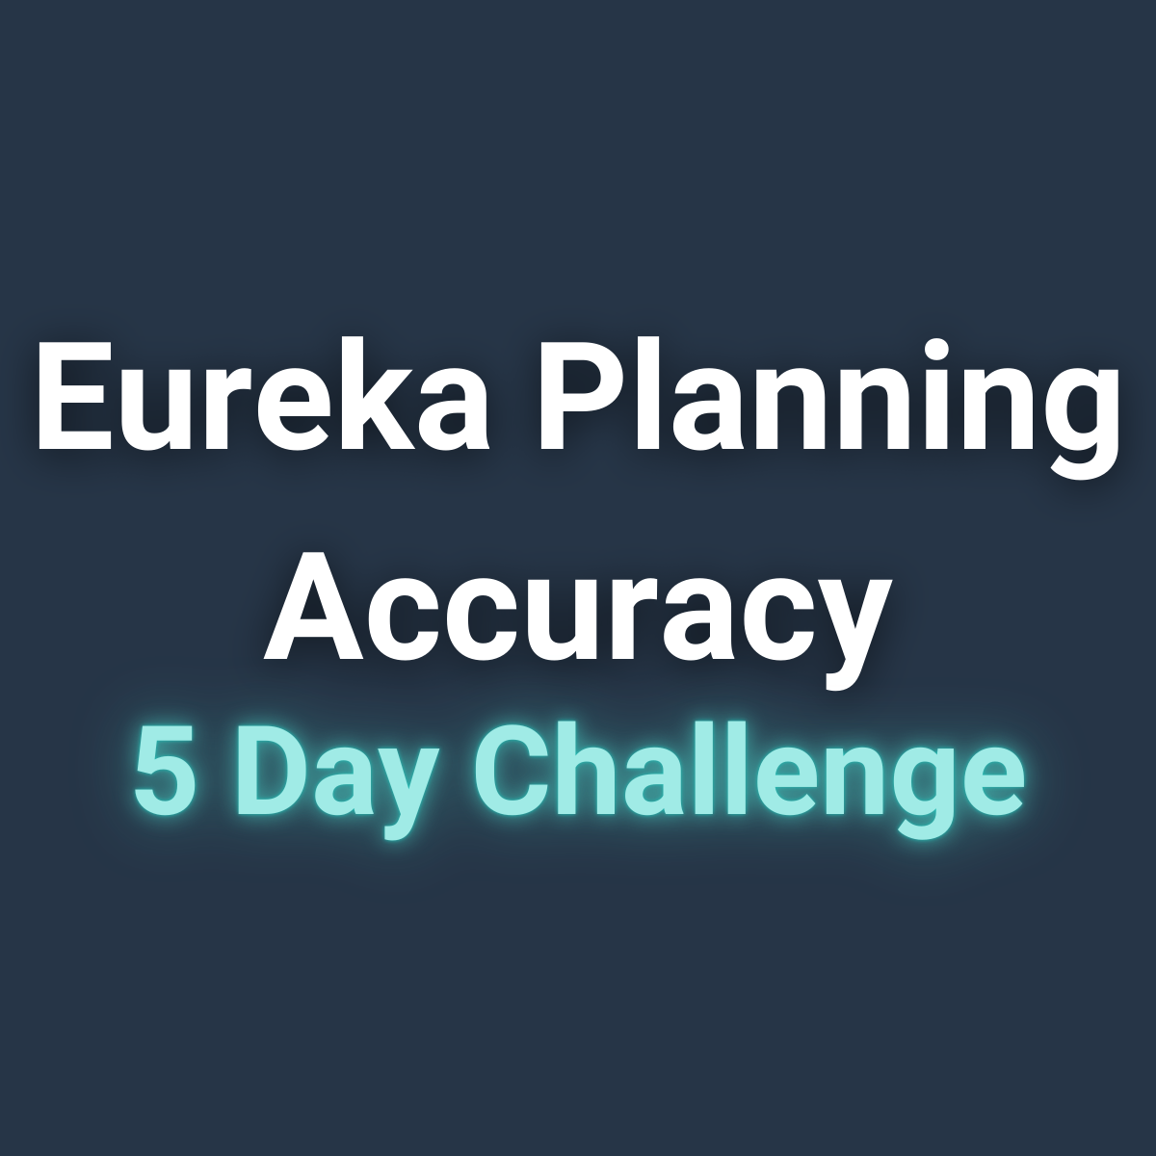
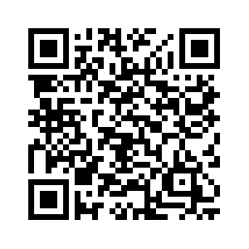
5 DAY CHALLENGE

Slide 40
Thank You
LinkedIn: in/deniscahuk/
Substack: 🔮 Crafting Tech Teams
Denis Čahuk
Engineering Leadership Coach

